Slide 1
Our planet
By alberto tarrasa

Slide 2
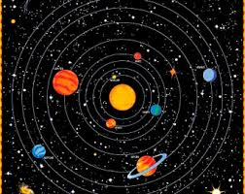
Our planet
Our planet is part of the Solar System, which is formed by 8 planets thet orbit the Sun. The Earth takes the 3rd place.

Slide 3
The earth
Our planet is the fifth largest planet in the Solar System and the largest of the rocky planets.
Its Surface is 510.1 km2, and it is 149.6 million km from the Sun

Slide 4
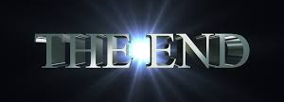
Our planet
By Alberto Tarrasa

